Slide 1
Healthcare Management : Patient Readmission Prediction

Slide 2
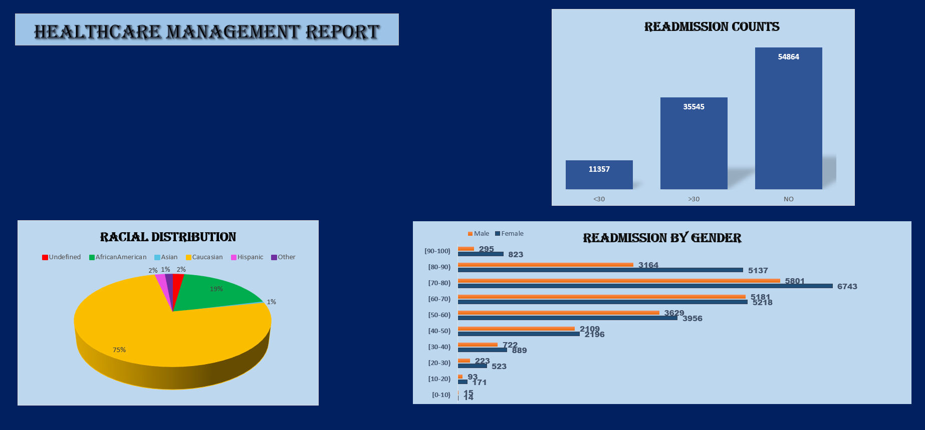

Slide 3

Calculate the total number of patient encounters

Slide 4
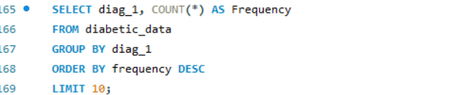
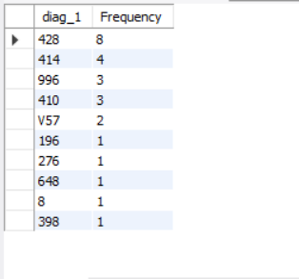
top 10 most frequent diagnoses in the dataset

Slide 5

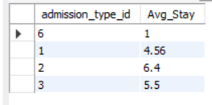
average length of hospital stay for each admission type

Slide 6
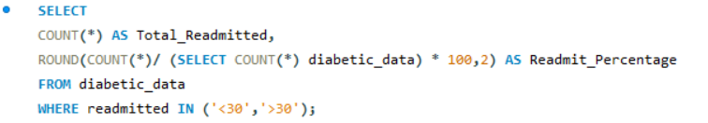
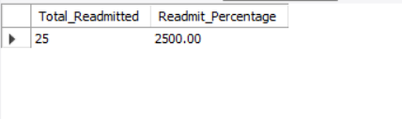
Total readmitted patients and the percentage of total encounters that they represent

Slide 7
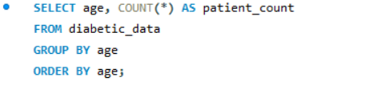
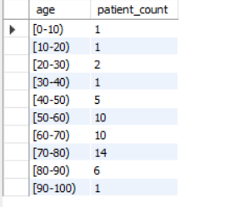
age distribution of patients

Slide 8
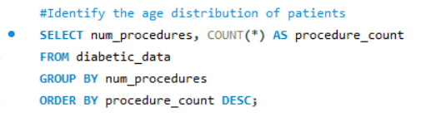
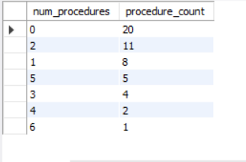
most common procedures performed during patient encounters

Slide 9
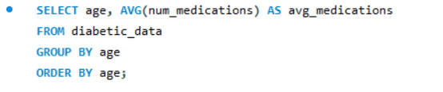
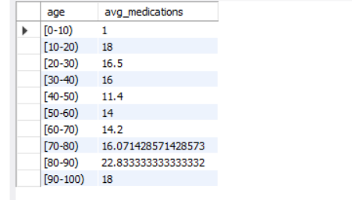
average number of medications prescribed for patients in each age group

Slide 10
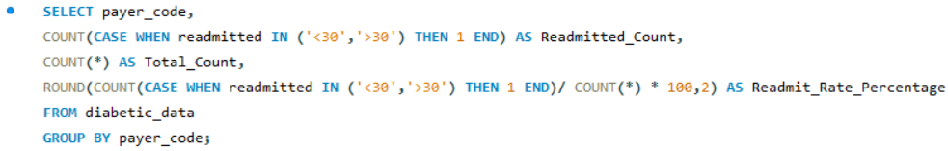

distribution of readmission rates across different payer codes

Slide 11
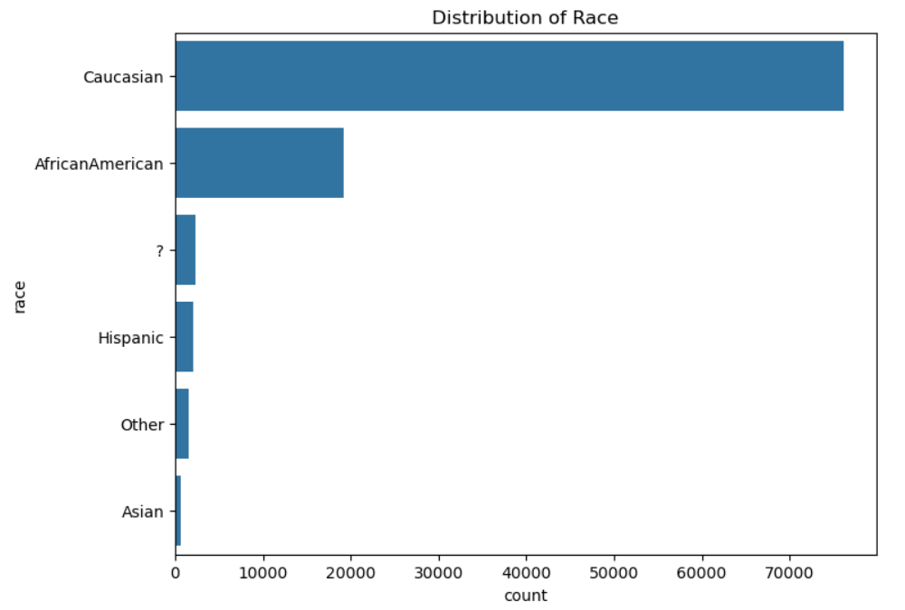
Visualization of racial distribution of patients

Slide 12
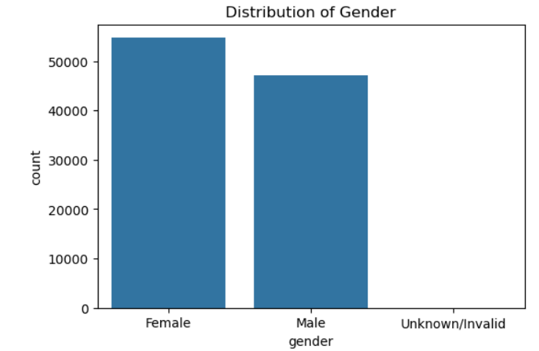
VISUALIZATION OF GENDER DISTRIBUTION OF PATIENTS

Slide 13
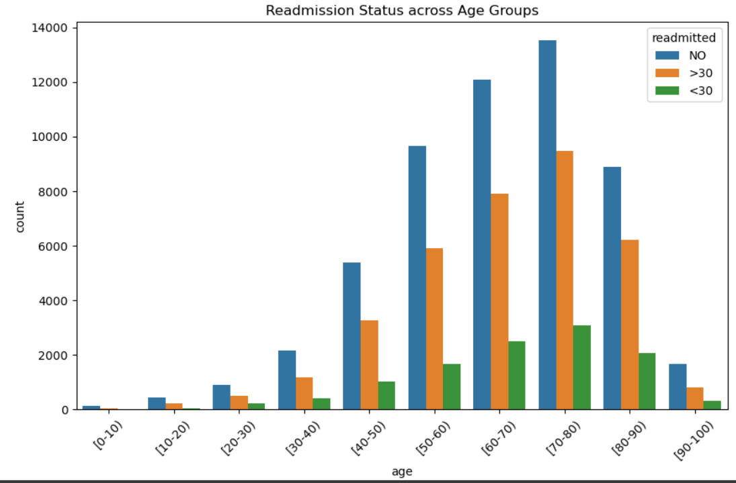
VISUALIZATION OF READMISSION OF PATIENT AND THEIR AGE GROUP

Slide 14
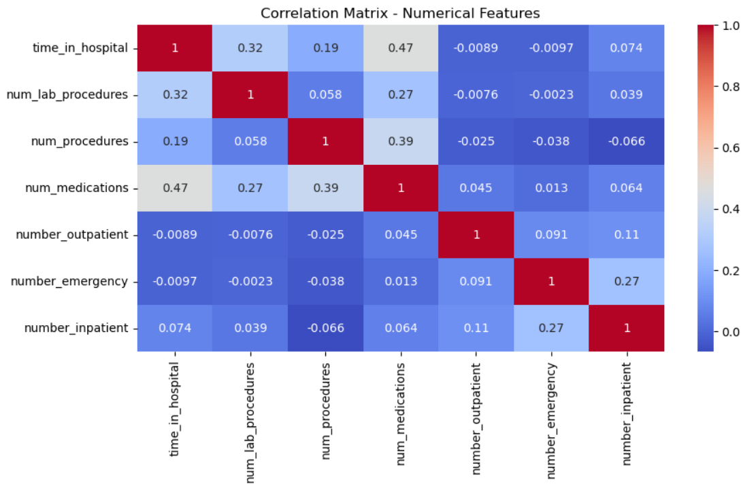
Associations Between Several Healthcare Features

Slide 15
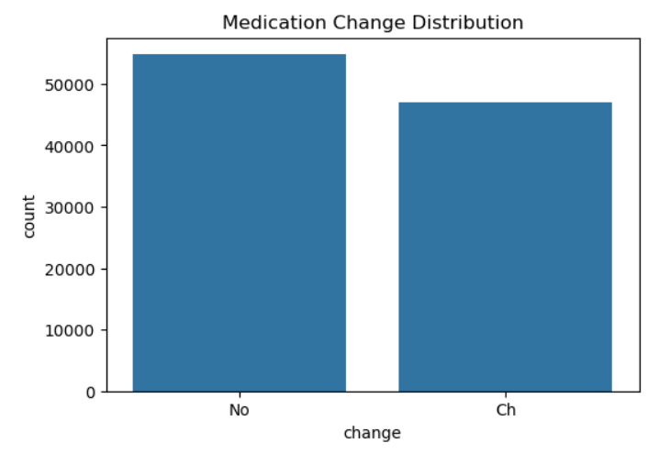
Visualization of Change in Medication and Total Medications Taken

Slide 16
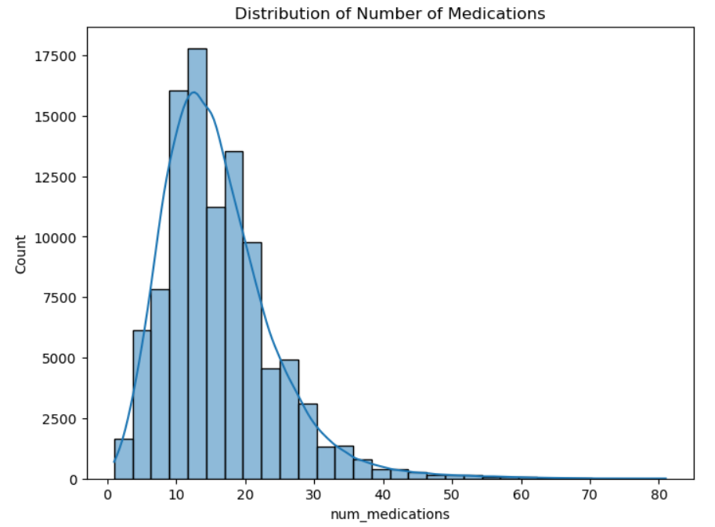
Visualization of Total Number of Medications and Patients

Slide 17
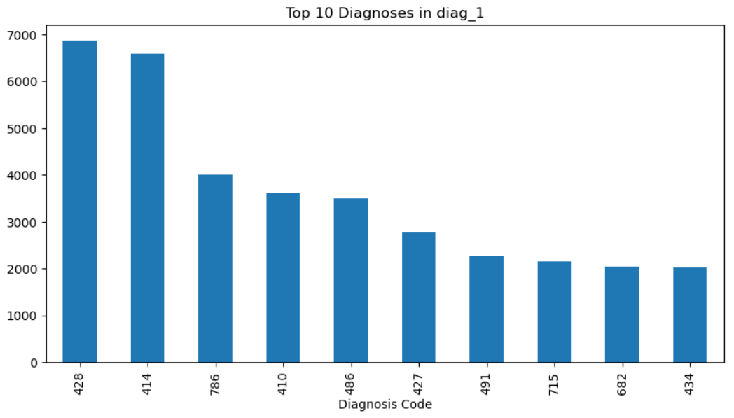
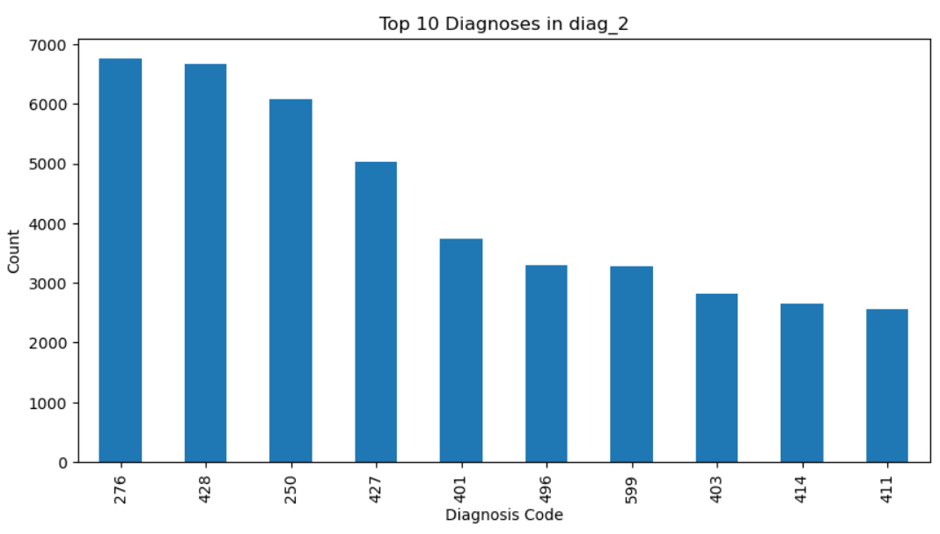
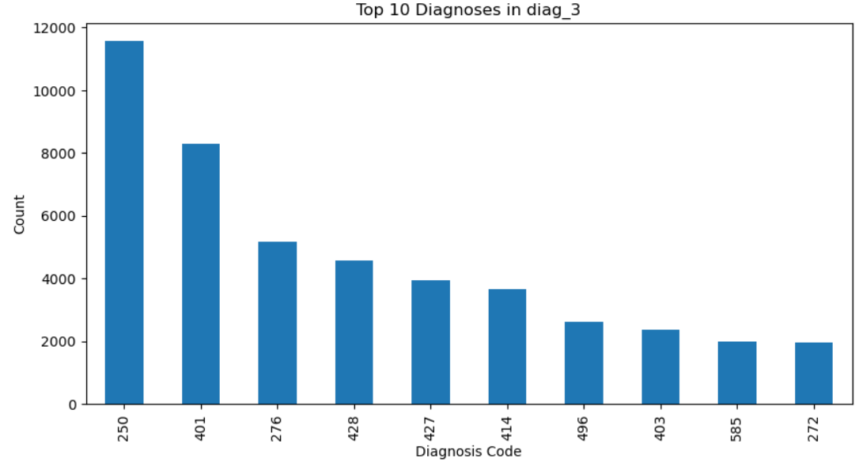
Visualization OF number of Patients with DIFFERENT category of diseases

Slide 18
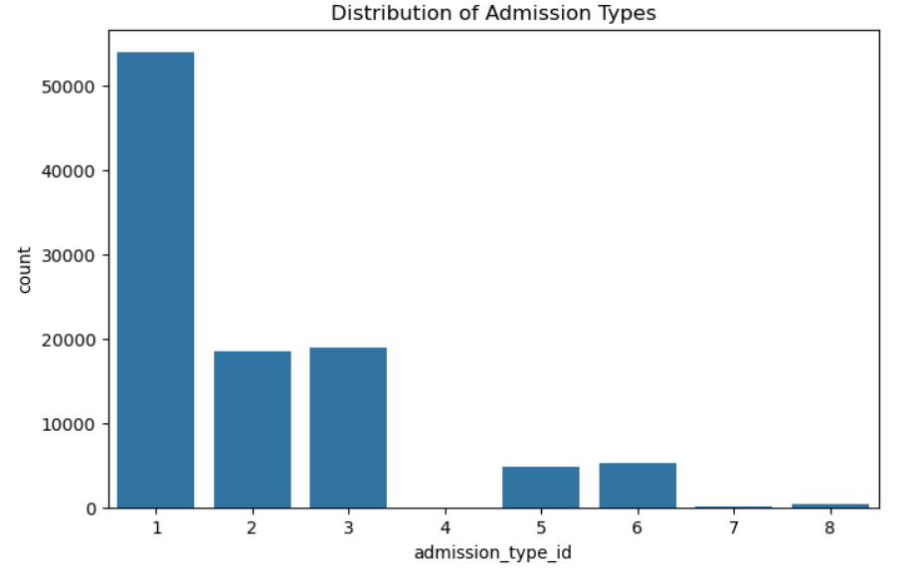
DISTRIBUTION OF types of admission with number of patients

Slide 19
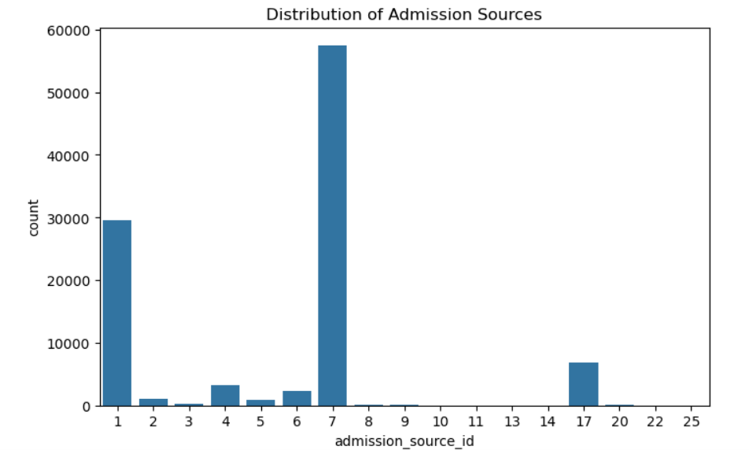
DISTRIBUTION OF SOURCES of admission AND number of patients

Slide 20
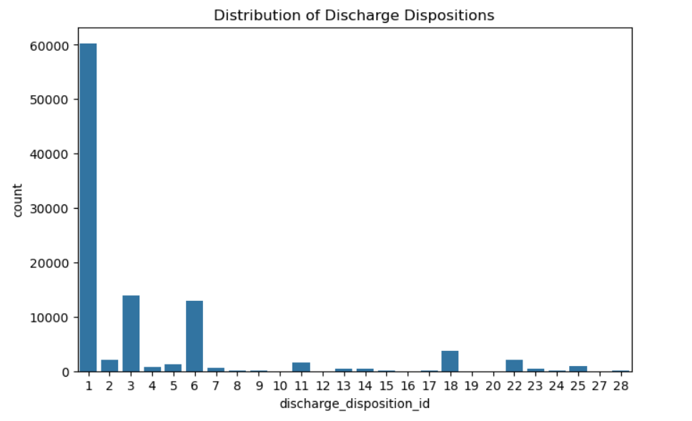
DISTRIBUTION OF DISCHARGES with number of patients

Slide 21
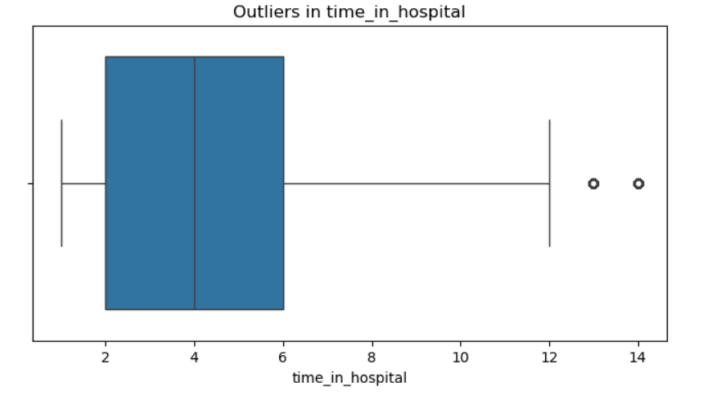
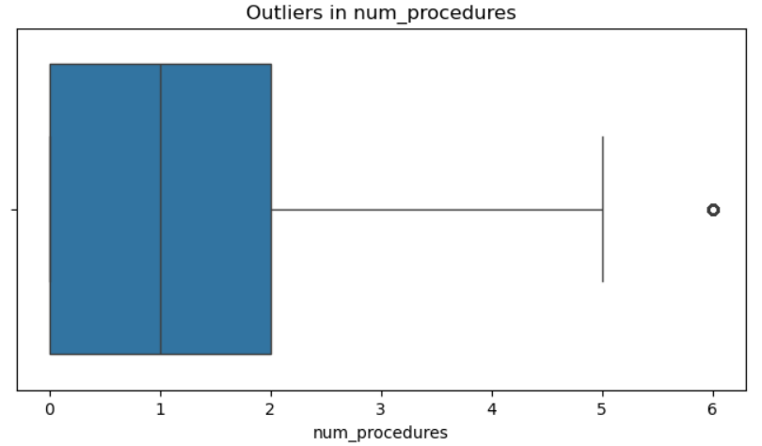
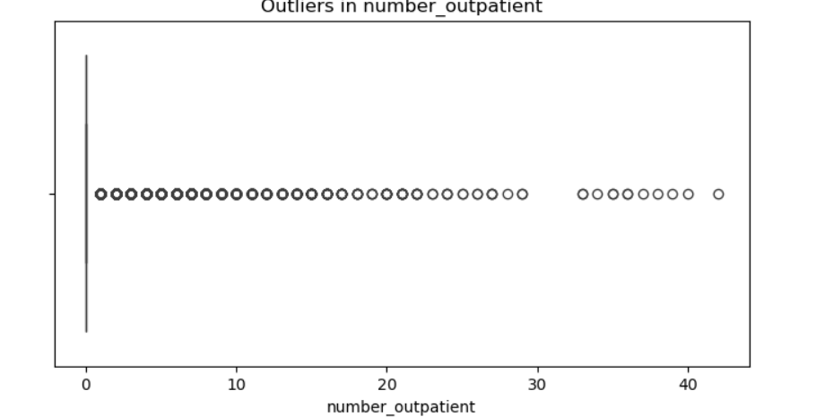
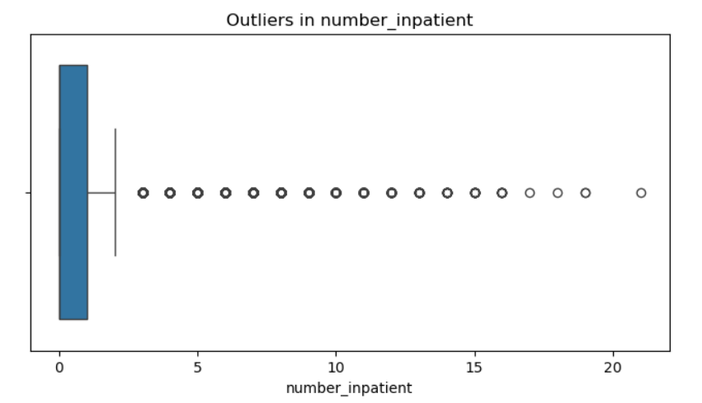
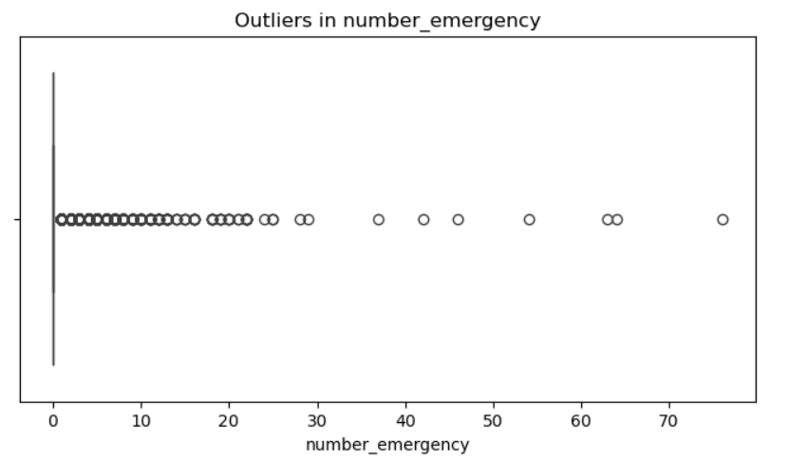
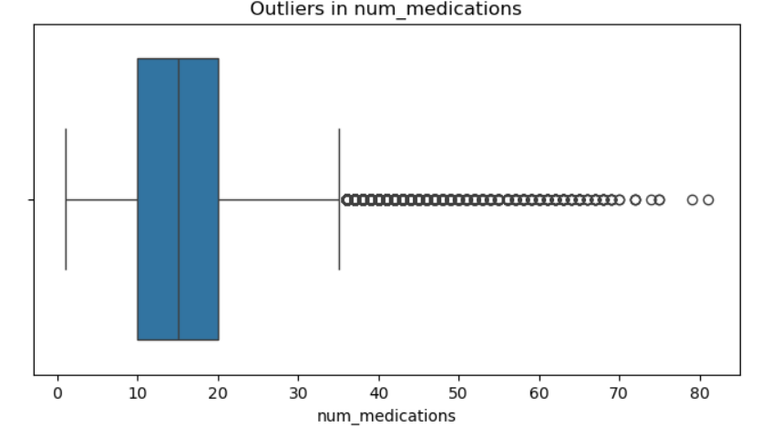
Detection of Anomalies in Several Fields

Slide 22
